Slide 1
Reasoning About Data Trees using CHCs
Marco Faella
U. Naples Federico II, Italy
Gennaro Parlato
U. Molise, Italy

Slide 2
What is this talk about?
An automatic procedure for deciding properties of data trees
Symbolic Data
Tree Automata
Emptiness
(undecidable)
MSO-D
(MSO + Data logic)
Satisfiability
Constrained
Horn Clauses (CHC)
Satisfiability
when Data logic = quantifier-free FOL theories

Slide 3
Data Trees
binary tree + each node labelled with a tuple of values
Data signature:
Examples:
Binary Search Trees
Data Signature:
Red-Black Trees
Data Signature:

Slide 4
MSO-D
A logic to characterize classes of data trees
Mso
data logic predicate
connecting functions
Notes:
The Mso component of the logic allows us to express structural properties, while the data constraint component allows us to impose properties on the data associated with the nodes. Constraints on data are expressed by predicates from the desired data logic that is completely agnostic to the underlying tree structure. We connect the two components by means of uninterpreted functions that map each node of the tree to a data item.

Slide 5
Example I: Binary Search Trees
Logical characterization
Data Signature:
predicate
MSO
connecting function

Slide 6
Example II: Red-black Trees
Logical characterization:
Every leaf is black:
If a node is red, both its children are black:
Every path from a node to a leaf has the same # of black nodes:
Data Signature:

Slide 7
Example II: Red-black Trees
3
Logical characterization:
Every leaf is black:
If a node is red, both its children are black:
Every path from a node to a leaf has the same # of black nodes:
2
2
2
2
2
2
1
1
1
1
1
1
1
1
1
1
1
1
1
1
Data Signature:
black height
Note that bh is not a field of the signature

Slide 8
Example III: Cinderella-Stepmother Game
Initially, all buckets are empty
Moves:
Stepmother pours water into any subset
of buckets, for a total of one liter.
Cinderella empties two adjacent buckets
Stepmother wins if a bucket overflows
Cinderella wins if the game continues forever

Slide 9
Example III: Cinderella-Stepmother Game
Initially, all buckets are empty
Moves:
Stepmother pours water into any subset
of buckets, for a total of one liter.
Cinderella empties two adjacent buckets
Stepmother wins if a bucket overflows
Cinderella wins if the game continues forever
Farzan, Kincaid : Strategy synthesis for linear arithmetic games POPL 2018
Beyene, Chaudhuri, Popeea, Rybalchenko : A constraint-based approach to solving games on infinite graphs POPL 2014

Slide 10
Example III: Cinderella-Stepmother Game
Initially, all buckets are empty
Moves:
Stepmother pours water into any subset
of buckets, for a total of one liter.
Cinderella empties two adjacent buckets
Stepmother wins if a bucket overflows
Cinderella wins if the game continues forever
We can build an Mso-D formula
φ_{n_bucket, capacity} that characterizes strategy trees of Stepmother
Farzan, Kincaid : Strategy synthesis for linear arithmetic games POPL 2018
Beyene, Chaudhuri, Popeea, Rybalchenko : A constraint-based approach to solving games on infinite graphs POPL 2014

Slide 11
Symbolic Data-Tree Automata (SDTA)
SDTA as a bottom-up acceptor of data trees
ALPHABET data signature
- symbol = evaluation
unary predicate defining
FINAL STATES
STATE data signature
- state = evaluation
TRANSITION FUNCTION (4 predicates)

Slide 12
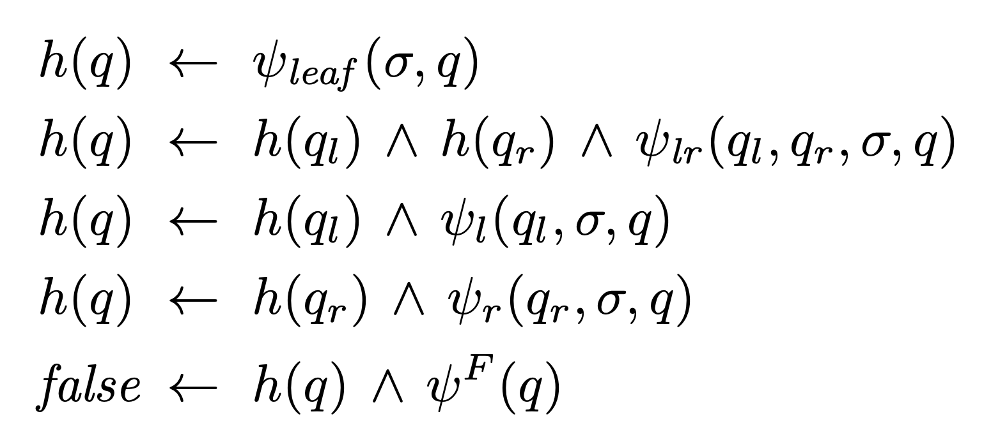
Emptiness of SDTAs
Emptiness of SDTAs is undecidable: simulate 2-counter machines
INVITED TALK TOMORROW: Program Verification with Constrained Horn Clauses (Arie Gurfinkel)
Emptiness of SDTAs → (un)satisfiability of CHC

Slide 13
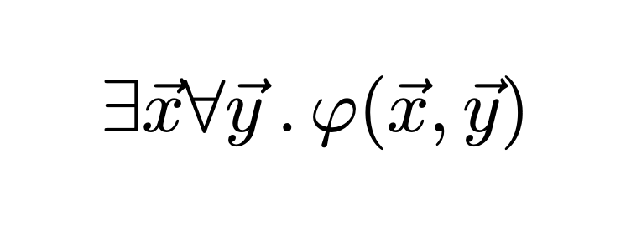
MSO-D sat → Emptiness of SDTAs
We give an effective reduction when the formula is of the form
$φ$ can have additional quantifiers
Data constraints can be either
unary or
r ( $\vec{x}$ , y_{j} )
D’Antoni, Veanes : Monadic second-order logic on finite sequences POPL 2017
: Automata modulo theories Commun. ACM 2021

Slide 14
Implementation
Architecture of the prototype tool
Z3 by Microsoft

Slide 15
Experiments
There exists an internal node whose black height is less than half of its height
In full BST (internal nodes have both children),
the successor of an internal node is not the left-most leaf in its right subtree

Slide 16
Conclusion
Mso-D as an extension of Mso on trees
SDTAs as extensions of FTAs for reasoning about data trees
we use CHC solvers to deal with undecidability
Key Idea: Separating the structural properties of interest from the data constraints makes it easier to reason and solve challenging problems
Future Directions
SDTAs: closure properties, decision problems through CHCs …
Handling of larger MSO-D fragments
Reasoning about data-manipulating programs
Extension of Courcelle's theorem
Infinite data trees, symbolic reachability games,
…

Slide 17
Thanks

Slide 18
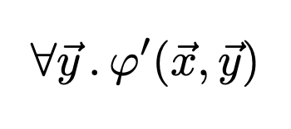
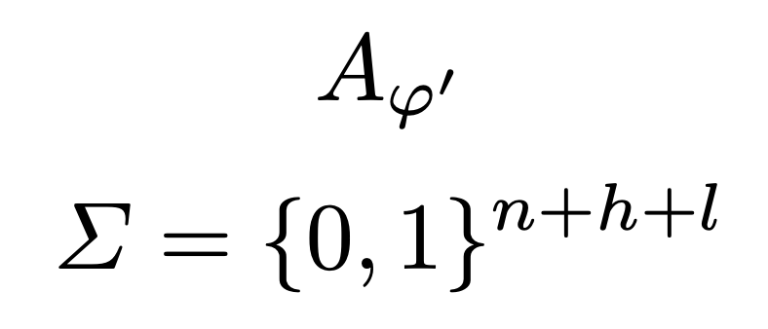
MSO-D sat → Emptiness of SDTAs
Original MSO-D formula
Standard MSO formula
x vars are free
abstract away all data constraints
r_{i}( $\vec{x}$ ) → p_{i} (prop var)
r_{i}( $\vec{x}$ , y_{j} ) → z∈ C_{i}
standard
MSO → tree automata
CHC system
Tree automata
$\vec{x}$ = ( x₁, …, x_{n} )
r₁( $\vec{x}$ ), … , r_{h}( $\vec{x}$ )
C₁, … , C_{l}
mimics the behavior of A$φ′$ and in doing so, it
enforces the data constraints in $φ$ according to
SDTA
Symbolic Data-Tree Automaton

